Slide 1
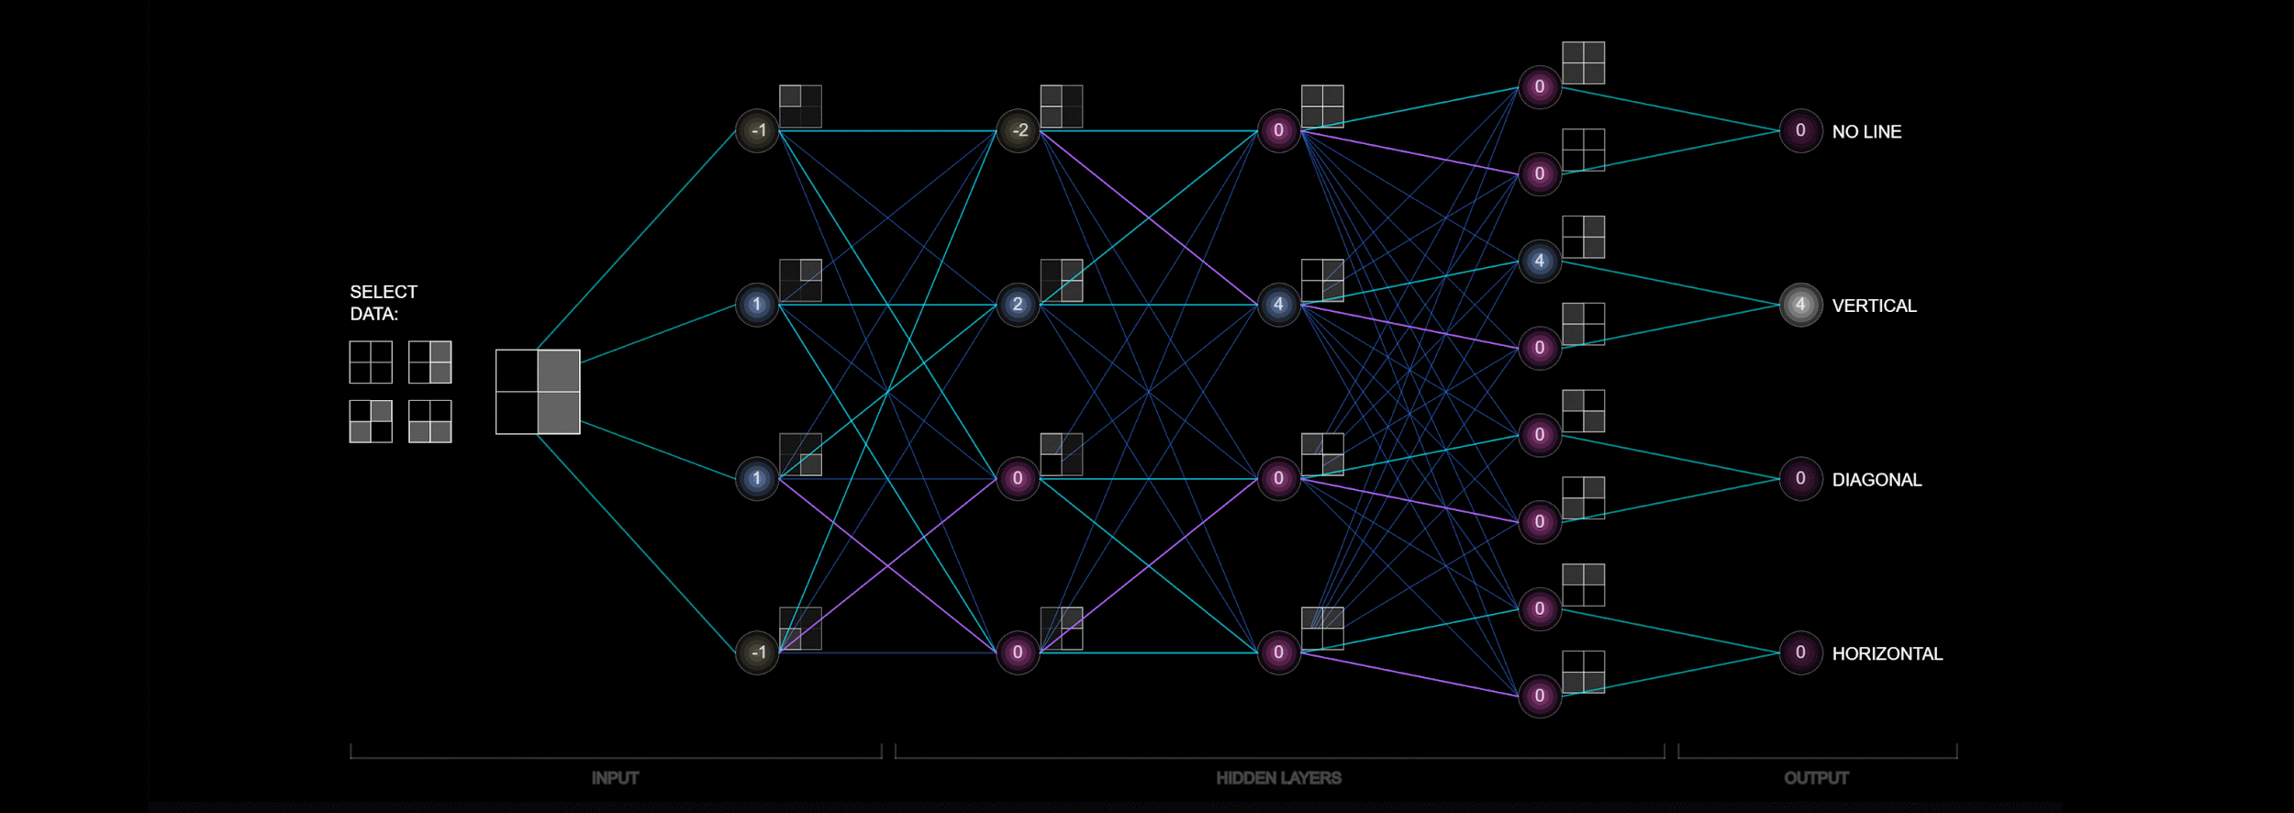
Notes:
Convolutional Neural Networks Explained (CNN Visualized)
—--Interactive Websites—--
3D Visualization of a Convolutional Neural Network
CNN Explainer

Slide 2
SIG AI
<welcome to>
Meeting 4: 04/18/24

Slide 4
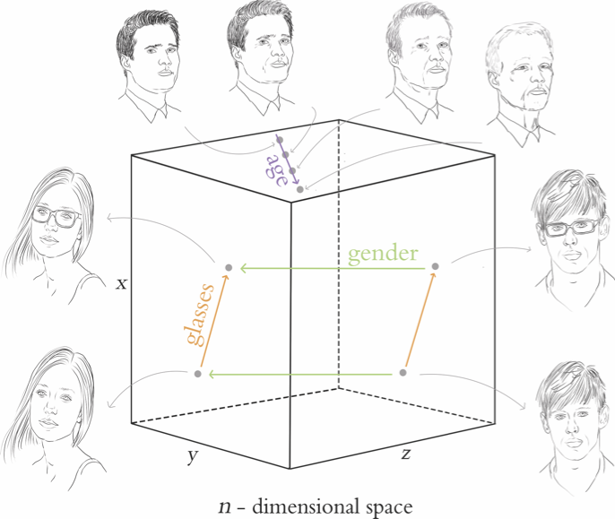

Slide 5
(ooga booga) What is Deep Learning?
Deep learning is a subset of machine learning that uses multi-layered neural networks, called deep neural networks, to simulate the complex decision-making power of the human brain. Some form of deep learning powers most of the artificial intelligence (AI) in our lives today.
By strict definition, a deep neural network, or DNN, is a neural network with three or more layers. In practice, most DNNs have many more layers. DNNs are trained on large amounts of data to identify and classify phenomena, recognize patterns and relationships, evaluate possibilities, and make predictions and decisions.
While a single-layer neural network can make useful, approximate predictions and decisions, the additional layers in a deep neural network help refine and optimize those outcomes for greater accuracy.
Notes:
Come back to this after teaching ‘Perceptron’, and a ‘neural network’

Slide 6
What use-case can you think of, where using unlabelled data might be beneficial, with more than just input-compute-output?
Notes:
Removing/Identifying duplicates

Slide 7
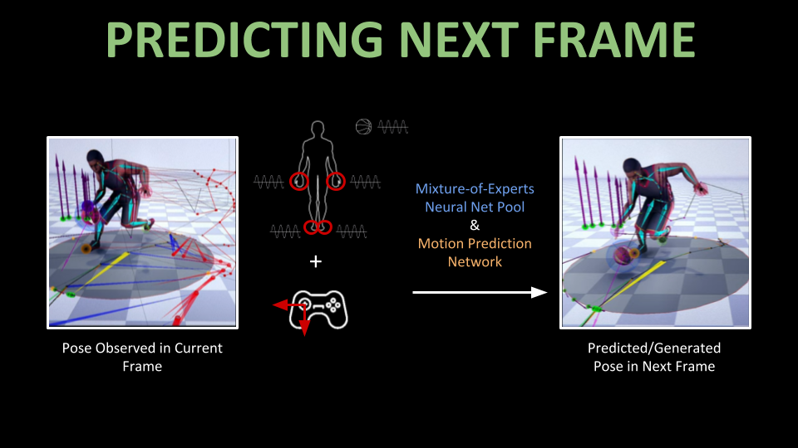
Notes:
Removing/Identifying duplicates

Slide 8
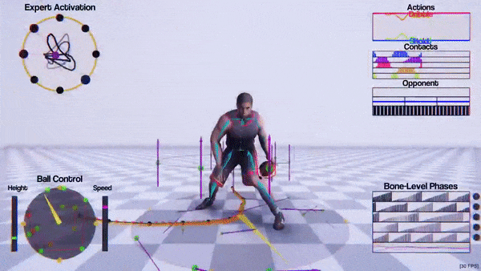
Notes:
SIGGRAPH 2020 | Learned Motion Matching
SIGGRAPH 2022: Adversarial Skill Embeddings
Channel: Ubisoft La Forge - YouTube

Slide 9
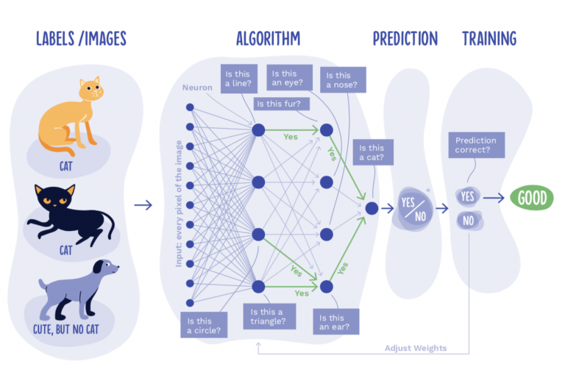
Notes:
Dalmatian example: all black spots on white fur isn’t a dalmatian

Slide 10
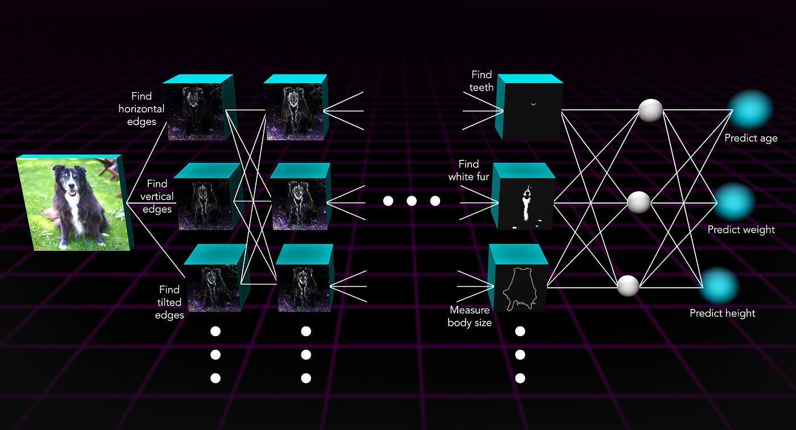
Notes:
Sounds like an easy problem, but for a ‘machine learning’ algorithm- this is extremely difficult. Everything thing it has been trained on, cats and pointy ears; dogs and big doe eyes- is falling out the window. How do you help your ML algorithm, when it has to generalise to such exceptions? Or, maybe, it has to be used for use cases beyond identification- and an incorrect identification could lead to incorrect medical analysis etc?
MORE LAYERS!!

Slide 11
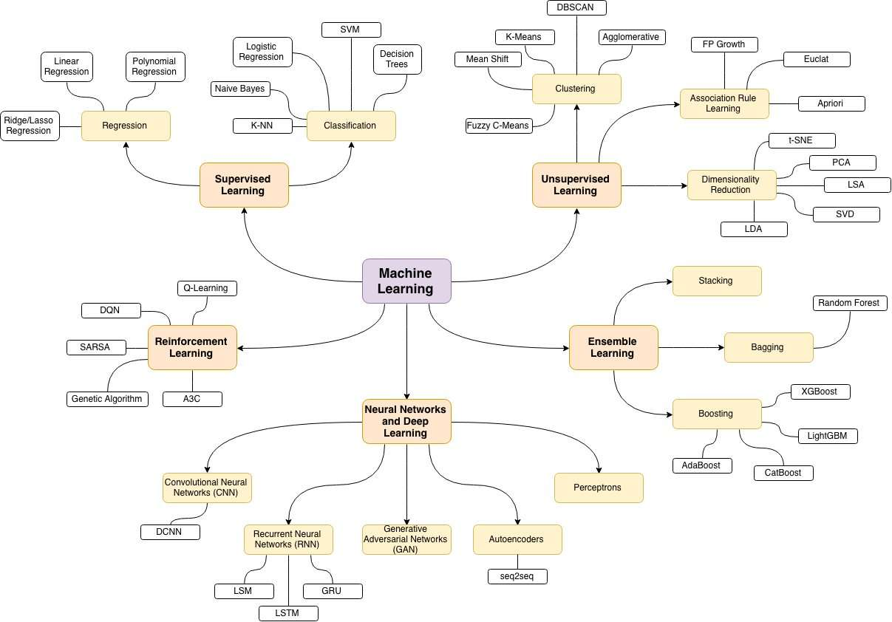

TODAY
Notes:
One of the best-known examples of a neural network is Google’s search algorithm.
Neural networks are sometimes called artificial neural networks (ANNs) or simulated neural networks (SNNs). They are a subset of machine learning, and at the heart of deep learning models.
The perceptron is the oldest neural network, created by Frank Rosenblatt in 1958.
Feedforward neural networks, or multi-layer perceptrons (MLPs), are what we’ve primarily been focusing on previously.
Convolutional neural networks (CNNs) are similar to feedforward networks, but they’re usually utilized for image recognition, pattern recognition, and/or computer vision. These networks harness principles from linear algebra, particularly matrix multiplication, to identify patterns within an image.
Recurrent neural networks (RNNs) are identified by their feedback loops. These learning algorithms are primarily leveraged when using time-series data to make predictions about future outcomes, such as stock market predictions or sales forecasting.
—-----------
MLPs, also known as feed-forward neural networks, are the most basic type of deep neural network. They consist of multiple layers of neurons, where data is fed to the input layer, there may be one or more hidden layers providing levels of abstraction, and predictions are made on the output layer. In MLPs, the only way information can travel to hidden layers is through previous layers.
MLPs are a good general-purpose network, while CNNs are more specialized for tasks involving image data.

Slide 12
Ok, what are the different types?
Perceptrons
Autoencoders
Convolution Neural Networks
(CNNs)
Generative Adversarial Networks (GANs)
Recurrent Neural Networks
(RNNs)

Slide 13
Ok, what are the different types?
Convolution Neural Networks
(CNNs)
Recurrent Neural Networks
(RNNs)
Generative Adversarial Networks (GANs)
Similar to feedforward networks, but they’re usually utilized for image recognition, pattern recognition, and/or computer vision. These networks harness principles from linear algebra, particularly matrix multiplication, to identify patterns within an image.
They are identified by their feedback loops. These learning algorithms are primarily leveraged when using time-series data to make predictions about future outcomes, such as stock market predictions or sales forecasting.
GANs create new output from the pattern found in the training dataset. In it two neurons are pitched against each other and creating a new output. These two neurons are generators and discriminators.

Slide 14
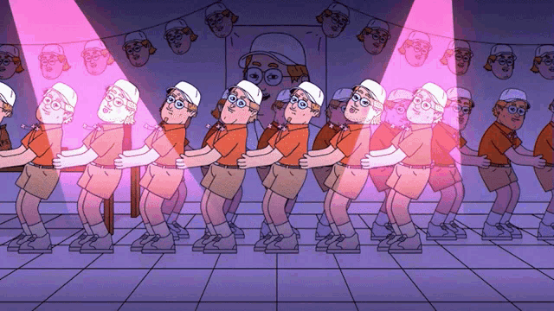
Secret Sauce of Neural Networks and Deep Learning ?
Notes:
https://www.youtube.com/watch?v=Ilg3gGewQ5U

Slide 15
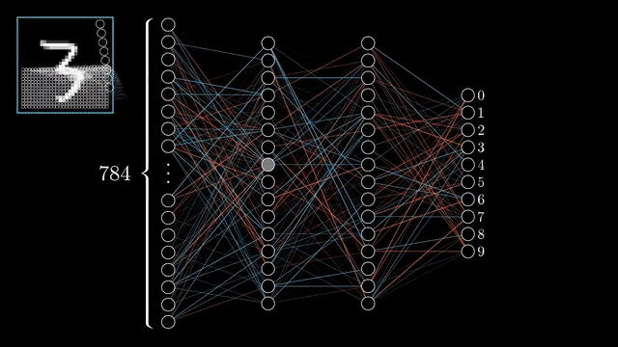
Secret Sauce of Neural Networks and Deep Learning ?
Notes:
https://www.youtube.com/watch?v=Ilg3gGewQ5U

Slide 16
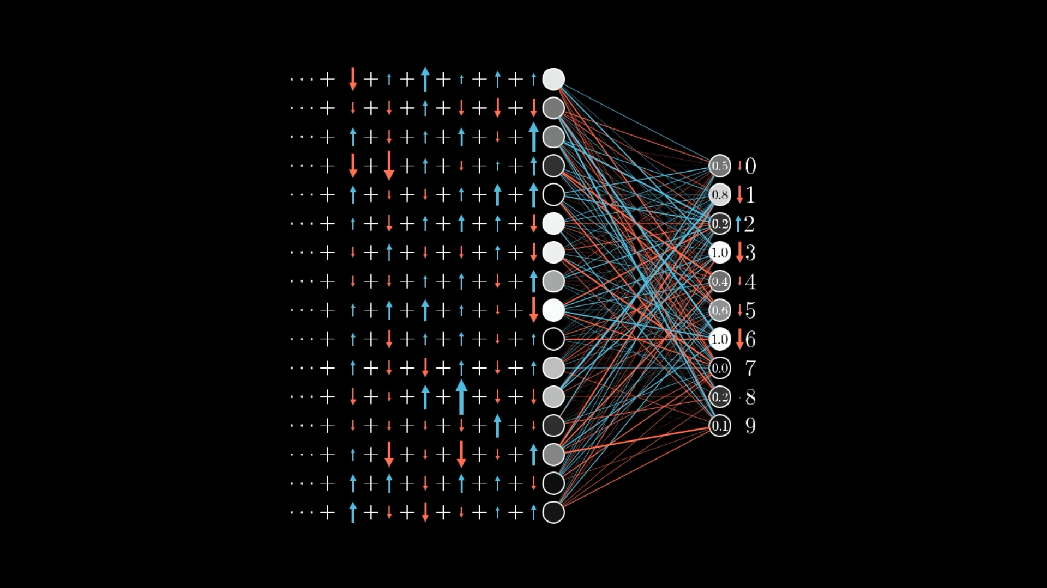
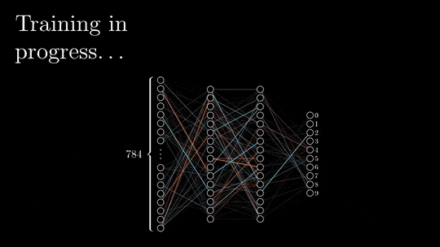
Secret Sauce of Neural Networks and Deep Learning ?

Slide 17
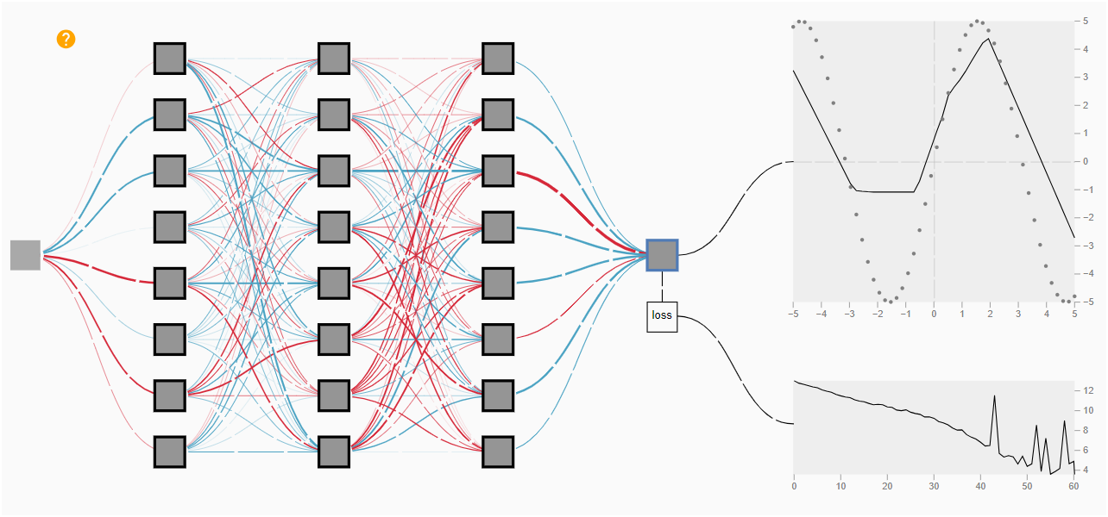
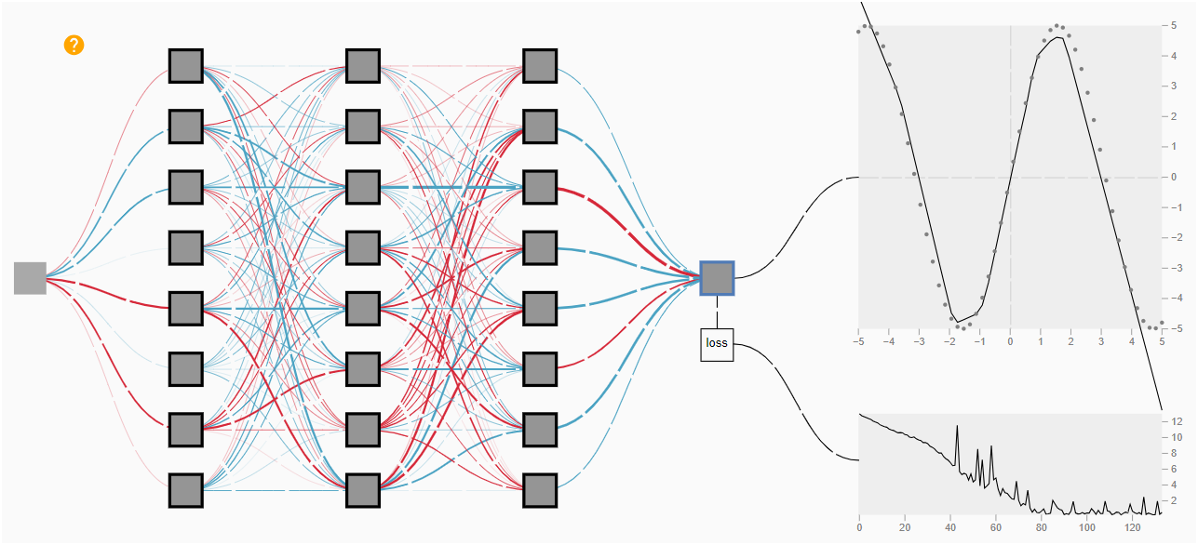
Interactive website for back propagation explanation:
Backprop Explainer
Constantly re-adjusts the weights according to gap between expected and predicted output, eventually minimizes error and converges!

Slide 18
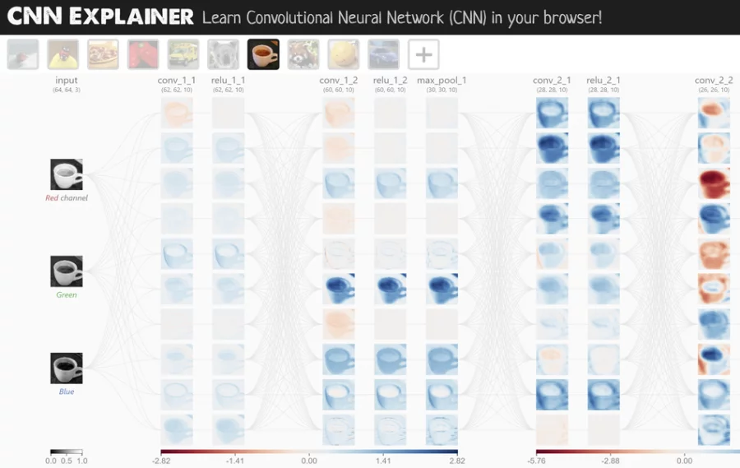
Convolution Neural Networks (CNNs)
Notes:
CNN Explainer

Slide 19
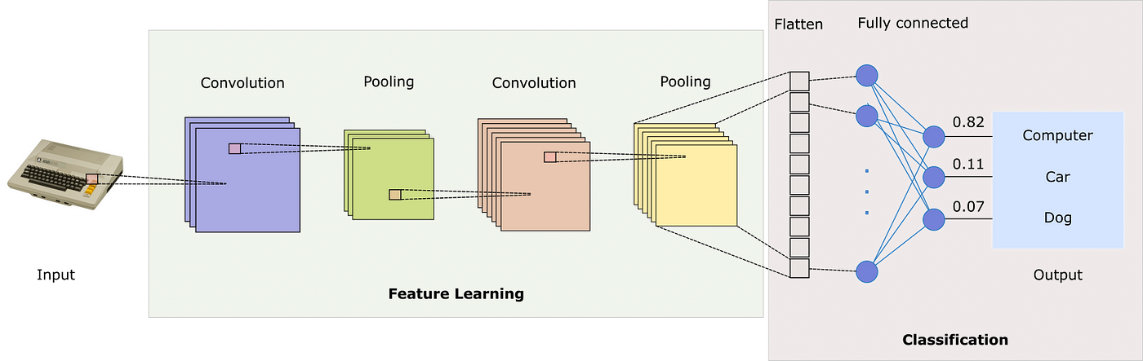
Convolution Neural Networks (CNNs):
What are they and why are they used?
Convolutional neural networks use three-dimensional data to for image classification and object recognition tasks.
Notes:
Convolutional neural networks (CNNs) are similar to feedforward networks, but they’re usually utilized for image recognition, pattern recognition, and/or computer vision. These networks harness principles from linear algebra, particularly matrix multiplication, to identify patterns within an image.
3D Visualization of a Convolutional Neural Network

Slide 20
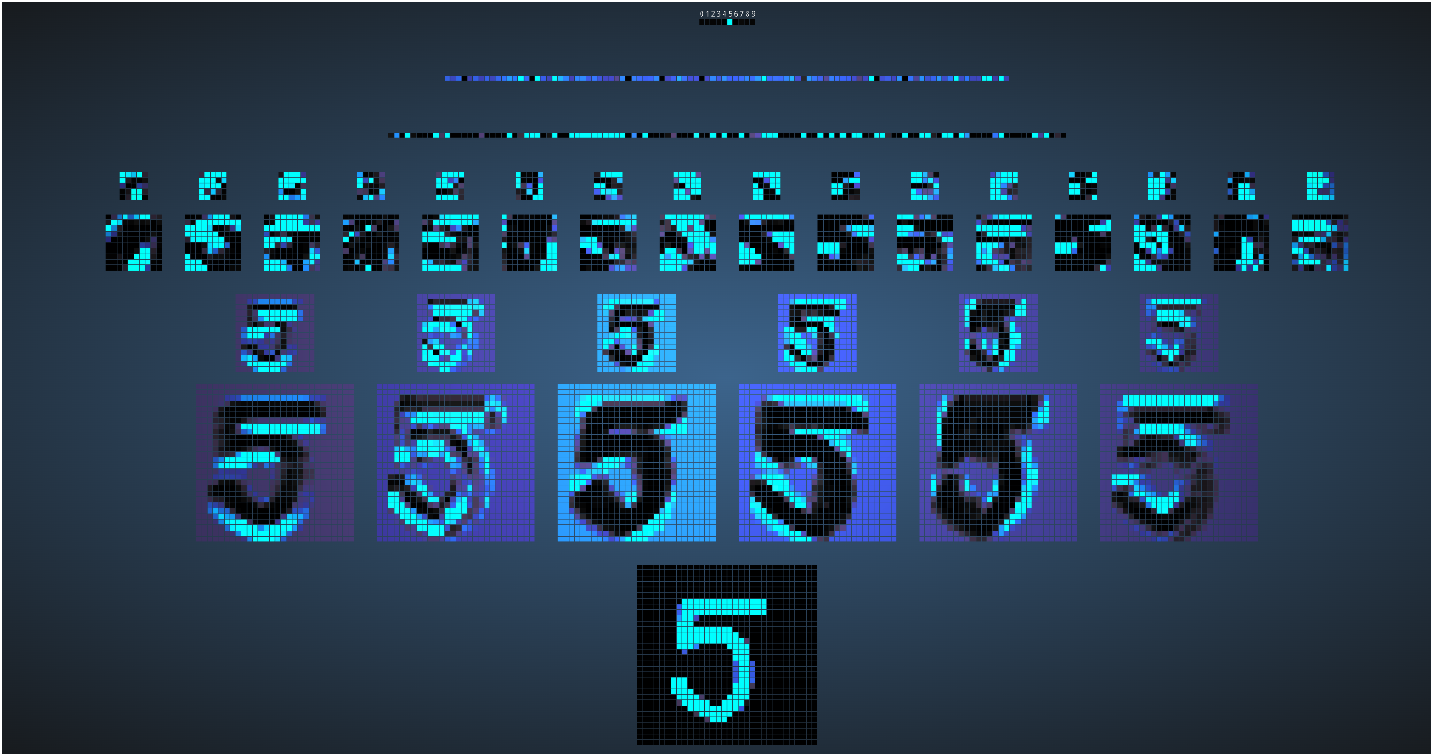
Convolution Neural Networks (CNNs):
Output Layer
Fully Connected 2
Fully Connected 1
Downsampling 2
CNN 2
Downsampling 1
CNN 1
Input Layer
Notes:
Convolutional neural networks (CNNs) are similar to feedforward networks, but they’re usually utilized for image recognition, pattern recognition, and/or computer vision. These networks harness principles from linear algebra, particularly matrix multiplication, to identify patterns within an image.
3D Visualization of a Convolutional Neural Network
GitHub - aharley/nn_vis: An interactive visualization of neural networks

Slide 21
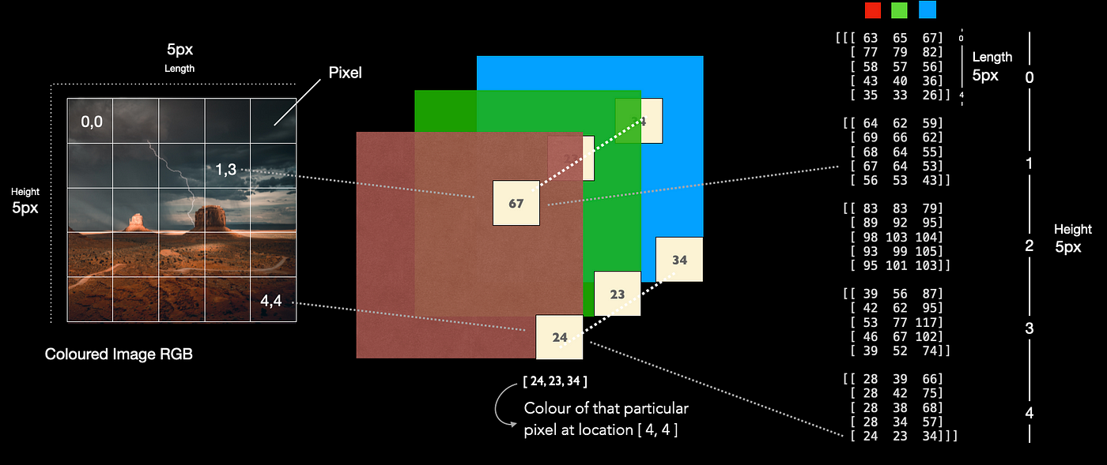
CNNs: Input Layer
Notes:
Understanding the Structure of RGB Images and How Pixel Values Represent Color | by Frederik vom Lehn | Advanced Deep Learning | Medium
Let’s have an example. In the illustration above, imagine the picture on the left only has a size of 5x5 pixels. Thus, the image consist of 25 pixels in total. In reality, we would barley see a picture this small, but it is a good size for illustration purposes. As you can see the image has a grid. This grid can be used to access each pixel. On the right, we see how the python library OpenCV (cv2) stores this particular picture, namley in matrices with a shape of [5,5,3].
The last index (3) indicates the three different colours Red, Green, Blue. If we now access one particular pixel, for instance at location [4,4] we receive the pixel values [24,23,34].
The first value depicts the intensity for the colour red, the second one represents the intensity for the colour green and the last one for blue. In combination, those three colours yield a new colour which is depicted at this particular pixel location. Those values range from 0–255.

Slide 22

CNNs: Convolution Layer
This layer performs a dot product between two matrices, where one matrix is the set of learnable parameters otherwise known as a kernel, and the other matrix is the restricted portion of the receptive field.
As the name suggests, the main mathematical task performed is called convolution, which is the application of a sliding window function to a matrix of pixels representing an image. The sliding function applied to the matrix is called kernel or filter, and both can be used interchangeably.
In the convolution layer, several filters of equal size are applied, and each filter is used to recognize a specific pattern from the image, such as the curving of the digits, the edges, the whole shape of the digits, and more.
Put simply, in the convolution layer, we use small grids (called filters or kernels) that move over the image.
Each small grid is like a mini magnifying glass that looks for specific patterns in the photo, like lines, curves, or shapes. As it moves across the photo, it creates a new grid that highlights where it found these patterns.
Size of the ‘image’ is bound to reduce post convolution layer!

Slide 23
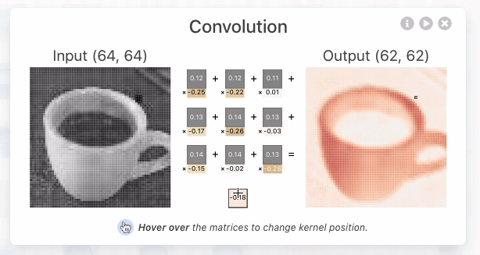
CNNs: Convolution Layer: Matrix Multiplication
Notes:
During the forward pass, the kernel slides across the height and width of the image-producing the image representation of that receptive region.
This produces a two-dimensional representation of the image known as an activation map that gives the response of the kernel at each spatial position of the image.
The sliding size of the kernel is called a stride.
CNN Explainer

Slide 24
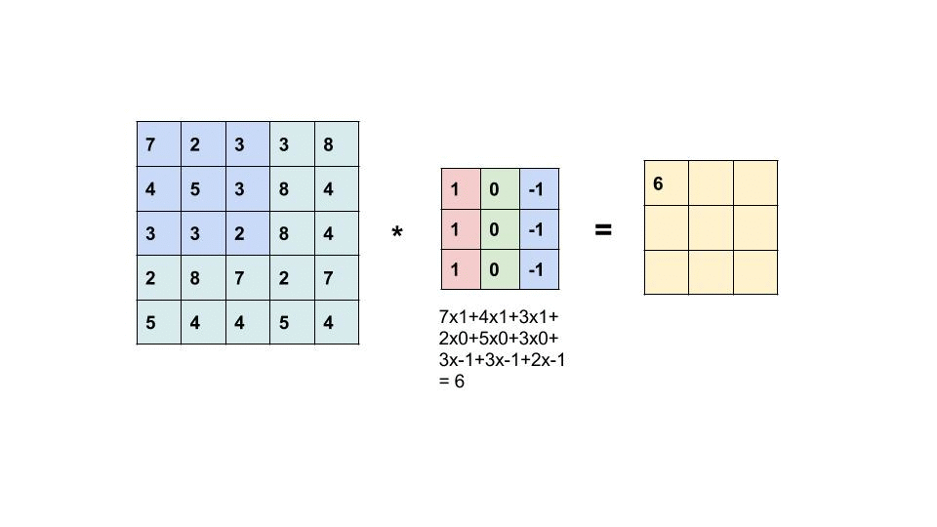
CNNs: Convolution Layer: Building a feature map
Input
Kernel/Filter/Grandma
Feature Map/Result of grandma’s nagging/Convoluted Matrice

Slide 25
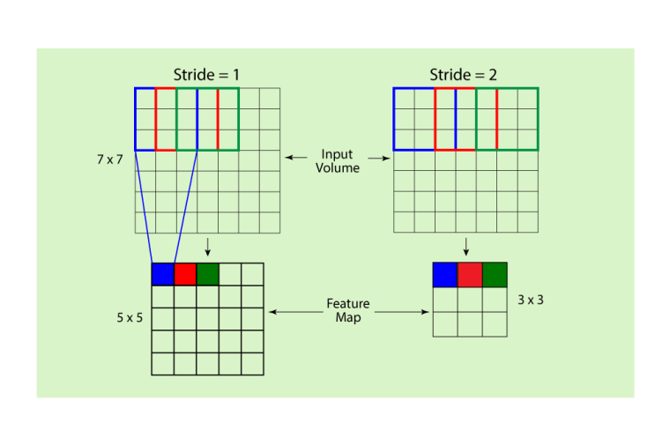
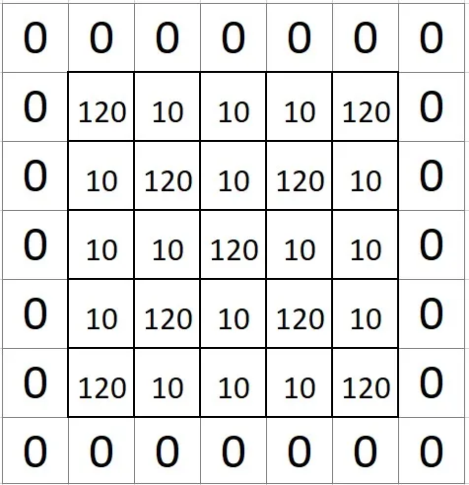
CNNs: Convolution Layer: Kernel Manipulation
QUESTION: would you pad the input image or output image?
Notes:
NOTE: output/input used interchangeably to reflect a smaller subset of operations and the BIG pictures
Effect of stride on feature map
Filter size
Role of padding = For example, if the size of the input image is 5x 5, the filter size is 3 x 3, the stride is 1 and we want the same size of the output image as the input image, the valid padding would be 1.

Slide 26
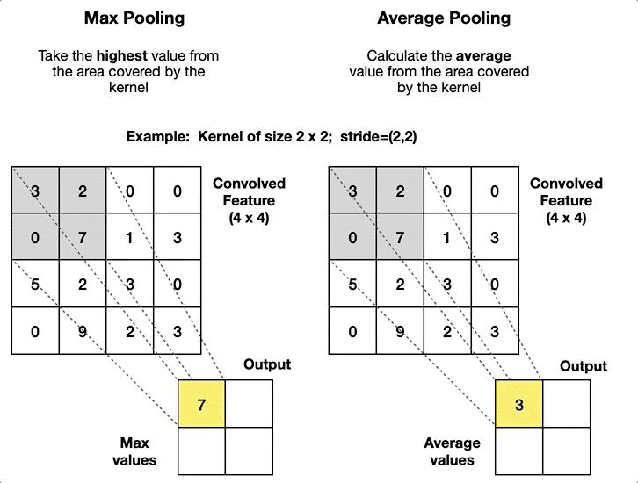
CNNs: Downsampling/Pooling Layer
Though machines are exceptionally fast, it will take quite some time to process these humongous number of pixel values.
One basic instinct would be to select a dominant value among the group.
This is achieved by the machines using an operation called Pooling.
The main motive for having the Pooling layer is for dimensionality reduction
The most common aggregation functions that can be applied are:
Max pooling, which is the maximum value of the feature map
Sum pooling corresponds to the sum of all the values of the feature map
Average pooling is the average of all the values.
Notes:
It is sometimes confused with image compression which is a different thing and serves a different use altogether. Here we are concerned with just the shrinking of the image. Well, what does that mean? That essentially means throwing away some of the (non-essential) information.
From this, we can draw a hint that we need to discard some of the rows and/or columns from the image. We need to give away some of the information.

Slide 27
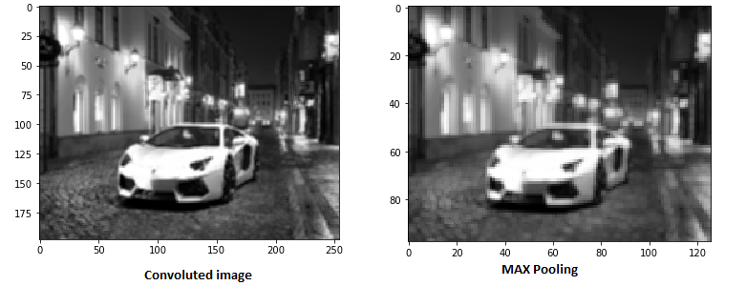
CNNs: Downsampling/Pooling Layer
Notes:
It is sometimes confused with image compression which is a different thing and serves a different use altogether. Here we are concerned with just the shrinking of the image. Well, what does that mean? That essentially means throwing away some of the (non-essential) information.
From this, we can draw a hint that we need to discard some of the rows and/or columns from the image. We need to give away some of the information.

Slide 28
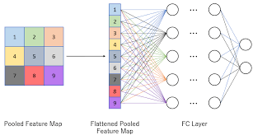
CNNs: Fully Connected Layer
These layers are in the last layer of the convolutional neural network, and their inputs correspond to the flattened one-dimensional matrix generated by the last pooling layer.
ReLU activations functions are applied to them for non-linearity.
They are used to flatten the 2D spatial structure of the data into a 1D vector and process this data for tasks like classification.
The weights and biases in FC layers are learned during the training process, making them adapt to the specific problem at hand.
The number of neurons in the final FC layer usually matches the number of output classes in a classification problem.
Full connectivity with all neurons in the preceding and succeeding layer
In this stage, the classification process begins to take place. The reason two layers are connected is that two fully connected layers will perform better than a single connected layer.
Notes:
https://www.youtube.com/watch?v=Ilg3gGewQ5U Back Propogation

Slide 29
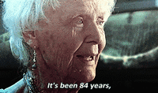

Slide 30
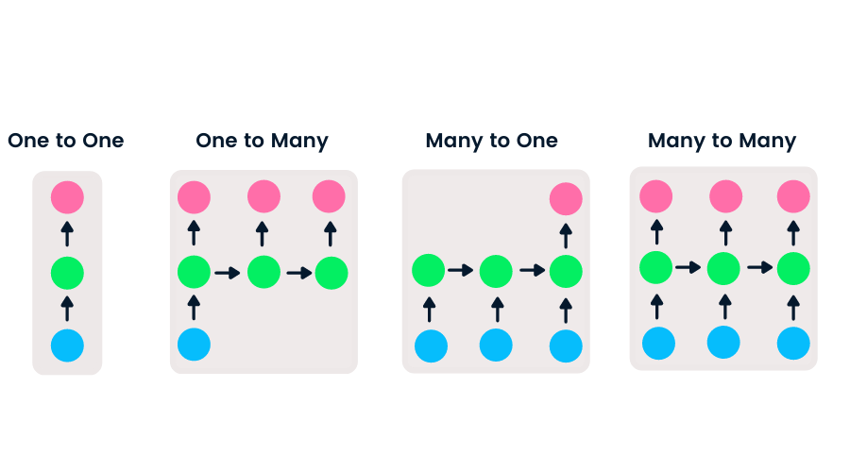
Recurrent Neural Networks (RNNs)
A recurrent neural network (RNN) is the type of artificial neural network (ANN) that is used in Apple’s Siri and Google’s voice search.
RNN remembers past inputs due to an internal memory which is useful for predicting stock prices, generating text, transcriptions, and machine translation.
Weights are same, amongst all nodes, within a layer.
They are distinguished by their “memory” as they take information from prior inputs to influence the current input and output.
While traditional deep neural networks assume that inputs and outputs are independent of each other, the output of recurrent neural networks depend on the prior elements within the sequence.
Notes:
They are distinguished by their “memory” as they take information from prior inputs to influence the current input and output. While traditional deep neural networks assume that inputs and outputs are independent of each other, the output of recurrent neural networks depend on the prior elements within the sequence.

Slide 31
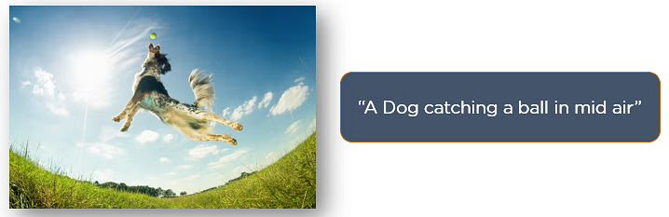
Recurrent Neural Networks (RNNs)
Notes:
They are distinguished by their “memory” as they take information from prior inputs to influence the current input and output. While traditional deep neural networks assume that inputs and outputs are independent of each other, the output of recurrent neural networks depend on the prior elements within the sequence.

Slide 32
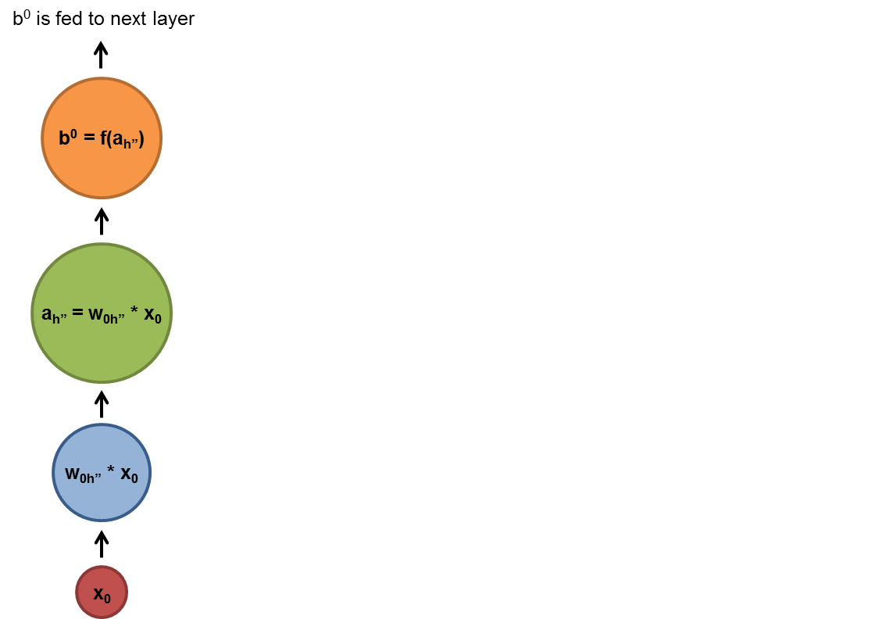

Recurrent Neural Networks (RNNs)
Notes:
They are distinguished by their “memory” as they take information from prior inputs to influence the current input and output. While traditional deep neural networks assume that inputs and outputs are independent of each other, the output of recurrent neural networks depend on the prior elements within the sequence.

Slide 33
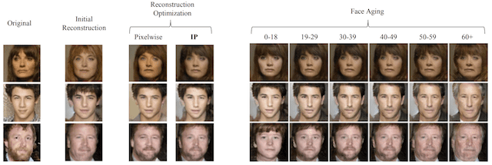
Generative Adversarial Networks (GANs)

Slide 34
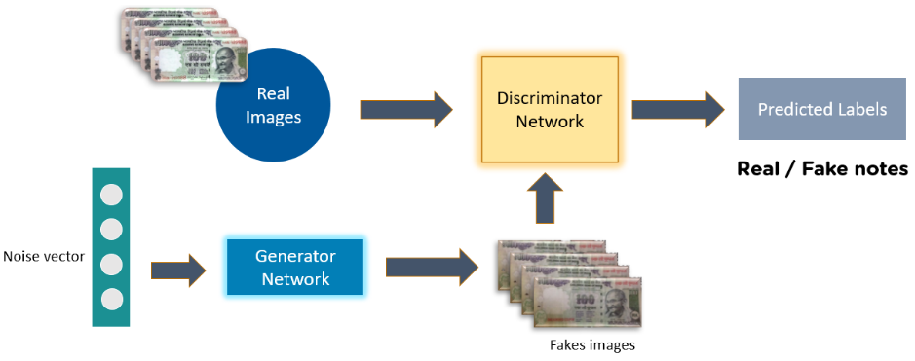
Generative Adversarial Networks (GANs)
Generative Adversarial Networks (GANs) were introduced in 2014 by Ian J. Goodfellow and co-authors. GANs perform unsupervised learning tasks in machine learning. It consists of 2 models that automatically discover and learn the patterns in input data.
The two models are known as Generator and Discriminator.
Notes:
With the help of DCGANs, you can train images of cartoon characters for generating faces of anime characters as well as Pokemon characters.
CartoonCharacters.
GANs can be trained on the images of humans to generate realistic faces. The faces that you see below have been generated using GANs and do not exist in reality.
RealisticFaces
GANs can build realistic images from textual descriptions of objects like birds, humans, and other animals. We input a sentence and generate multiple images fitting the description.

Slide 35
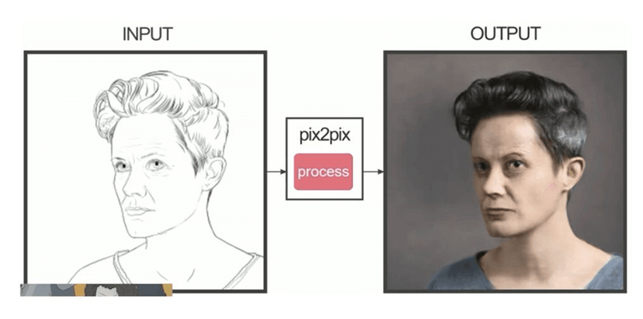
Generative Adversarial Networks (GANs)
Notes:
With the help of DCGANs, you can train images of cartoon characters for generating faces of anime characters as well as Pokemon characters.
CartoonCharacters.
GANs can be trained on the images of humans to generate realistic faces. The faces that you see below have been generated using GANs and do not exist in reality.
RealisticFaces
GANs can build realistic images from textual descriptions of objects like birds, humans, and other animals. We input a sentence and generate multiple images fitting the description.

Slide 36
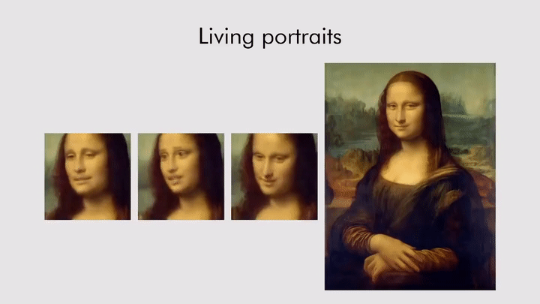
Generative Adversarial Networks (GANs)
Notes:
With the help of DCGANs, you can train images of cartoon characters for generating faces of anime characters as well as Pokemon characters.
CartoonCharacters.
GANs can be trained on the images of humans to generate realistic faces. The faces that you see below have been generated using GANs and do not exist in reality.
RealisticFaces
GANs can build realistic images from textual descriptions of objects like birds, humans, and other animals. We input a sentence and generate multiple images fitting the description.

Slide 37
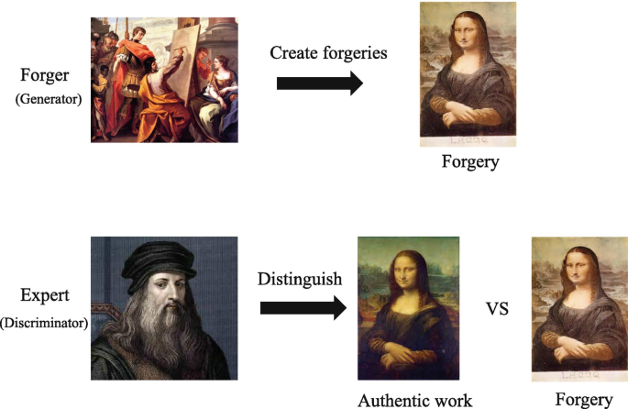
Generative Adversarial Networks (GANs)
Notes:
With the help of DCGANs, you can train images of cartoon characters for generating faces of anime characters as well as Pokemon characters.
CartoonCharacters.
GANs can be trained on the images of humans to generate realistic faces. The faces that you see below have been generated using GANs and do not exist in reality.
RealisticFaces
GANs can build realistic images from textual descriptions of objects like birds, humans, and other animals. We input a sentence and generate multiple images fitting the description.

Slide 38
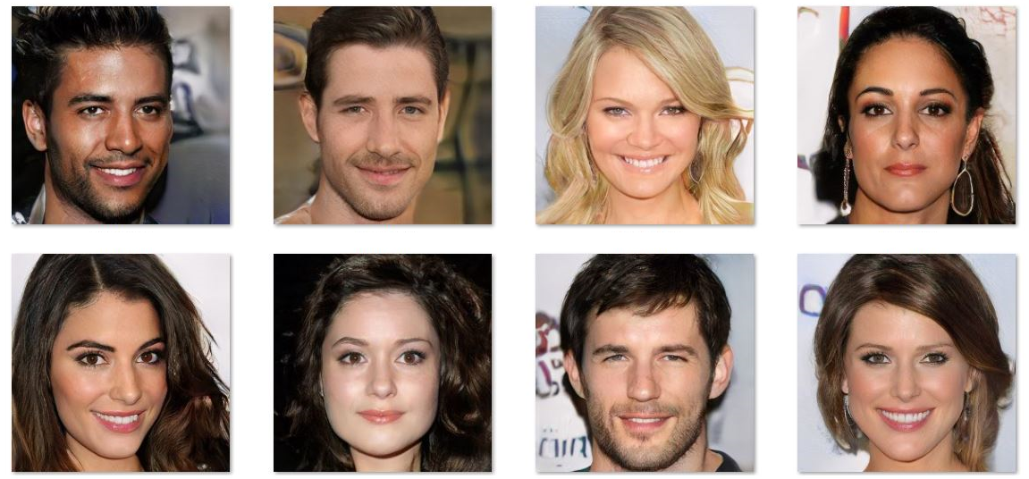
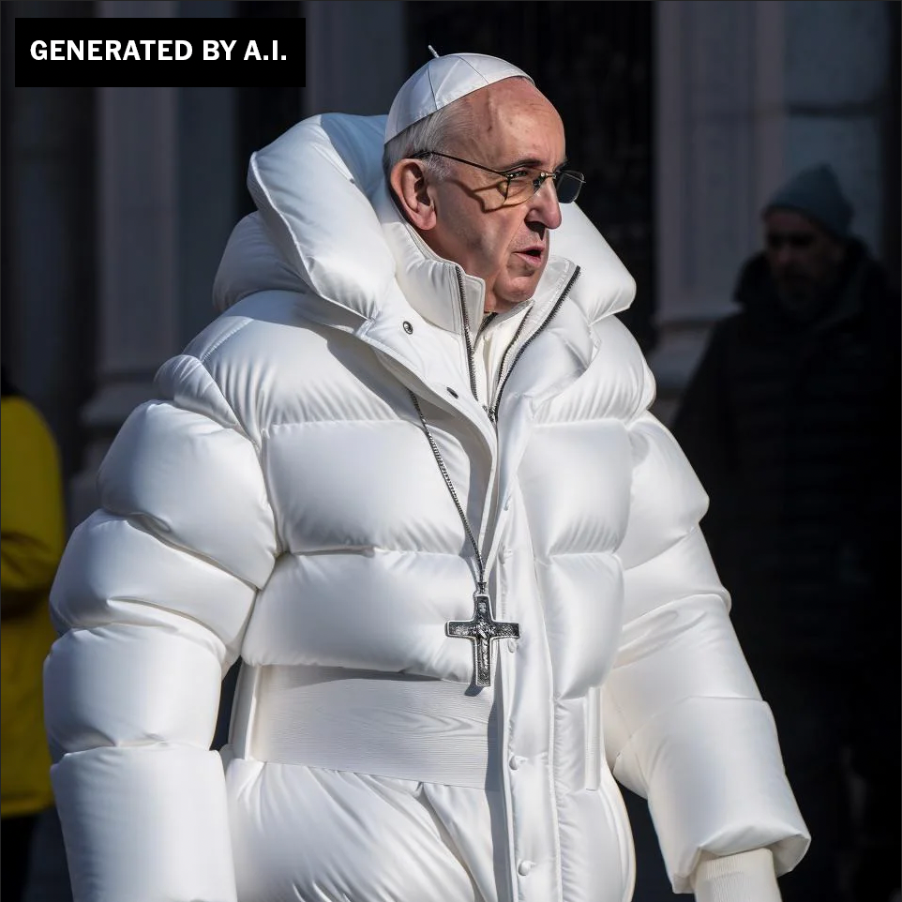
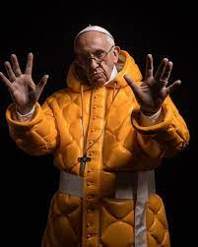
Generative Adversarial Networks (GANs)
Notes:
None of the images you’re looking at are original/true
Mesmerizing AI Generated DF Video mimicking Morgan Freeman. A class of deep-learning algorithms called generative adversarial networks (GANs) are the main engine of deepfakes development. GAN-generated faces are near-impossible to tell from real faces. .

Slide 39
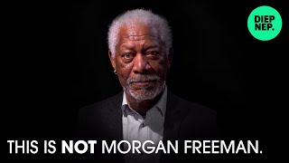
Generative Adversarial Networks (GANs)
Notes:
None of the images you’re looking at are original/true
Mesmerizing AI Generated DF Video mimicking Morgan Freeman. A class of deep-learning algorithms called generative adversarial networks (GANs) are the main engine of deepfakes development. GAN-generated faces are near-impossible to tell from real faces. .

